Slide 1
Design patterns
Design patterns are template solutions that developers have refined over time to solve a range of recurring problems [Gamma et al., 1994]. A design pattern has four elements:
A name that uniquely identifies the pattern from other patterns.
A problem description that describes the situations in which the pattern can be used. Problems addressed by design patterns are usually the realization of modifiability and extensibility design goals and nonfunctional requirements.
A solution stated as a set of collaborating classes and interfaces.
A set of consequences that describes the trade-offs and alternatives to be considered with respect to the design goals being addressed.

Slide 2
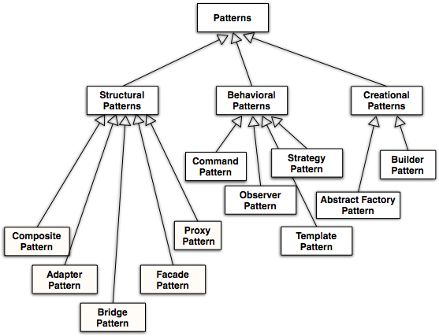
√

Slide 3
Figure 8-5, An example of design pattern: Adapter.
enables reuse since neither the ClientInterface nor the LegacyClass need to be modified
Client
ClientInterface
LegacyClass
Request()
ExistingRequest()
adaptee
Adapter
Request()
encourages extensibility, as the same Adapter class can be used for any subtypes of the LegacyClass

Slide 4
Figure 8-6, Applying the Adapter design pattern to the Set problem of Figure 8-3.
Client
Set
Hashtable
add(element)
put(key,element)
adaptee
MySet
add(element)

Slide 5
Figure 8-8, Applying the Adapter design pattern for sorting Strings in an Array. See source code in Figure 8-9.
Array
Comparator
MyString
compare()
greaterThan()
equals()
adaptee
MyStringComparator
compare()

Slide 6
Figure 8-9, Adapter design pattern example.
/* Existing target interface */
interface Comparator {
int compare(Object o1, Object o2);
/* ... */
}
/* Existing client */
class Array {
static void sort(Object [] a, Comparator c);
/* ... */
}
/* Existing adaptee class */
class MyString extends String {
boolean equals(Object o);
boolean greaterThan
(MyString s);
/* ... */
}
/* New adapter class */
class MyStringComparator implements Comparator {
/* ... */
int compare(Object o1, Object o2) {
int result;
if (o1.greaterThan(o2)) {
result = 1
} else if (o1.equals(o2)) {
result = 0;
} else {
result = -1;
}
return result;
}
}

Slide 7
Figure 8-7, Applying the Bridge design pattern for abstracting database vendors.
Consider the problem of incrementally developing, testing, and integrating subsystems realized by different developers. Subsystems may be completed at different times, delaying the integration of all subsystems until the last one is completed.
Arena
imp
LeagueStore
LeagueStoreImplementor
Stub Store
XML Store
JDBC Store
Implementor
Implementor
Implementor
To avoid this delay, projects often use a stub implementation in place of a specific subsystem so that the integration tests can start even before the subsystems are completed.

Slide 8
Strategy Pattern
Different algorithms exists for a specific task
  We can switch between the algorithms at run time
Examples of tasks:
  Different collision strategies for objects in video games
  Parsing a set of tokens into an abstract syntax tree (Bottom up, top down)
  Sorting a list of customers (Bubble sort, mergesort, quicksort)
Different algorithms will be appropriate at different times
  First build, testing the system, delivering the final product
If we need a new algorithm, we can add it without disturbing the application or the other algorithms.

Slide 9
Strategy Pattern
Policy
Context
ContextInterface()
*
Strategy
AlgorithmInterface
ConcreteStrategyA
AlgorithmInterface()
ConcreteStrategyB
AlgorithmInterface()
ConcreteStrategyC
AlgorithmInterface()
Policy decides which ConcreteStrategy is best in the current Context.

Slide 10
Using a Strategy Pattern to Decide between Algorithms at Runtime
Client
Policy
TimeIsImportant
SpaceIsImportant
Database
SelectSortAlgorithm()
Sort()
*
SortInterface
Sort()
BubbleSort
Sort()
QuickSort
Sort()
MergeSort
Sort()

Slide 11
Figure 8-10, Applying the Strategy pattern for encapsulating multiple implementations of a NetworkInterface.
Application
NetworkConnection
NetworkInterface
send()
open()
receive()
close()
setNetworkInterface()
send()
LocationManager
receive()
Ethernet
WaveLAN
UMTS
open()
open()
open()
close()
close()
close()
send()
send()
send()
receive()
receive()
receive()
The LocationManager implementing a specific policy configures NetworkConnection with a concrete NetworkInterface (i.e., the mechanism) based on the current location. The Application uses the NetworkConnection independently of concrete NetworkInterfaces.

Slide 12
Abstract Factory Pattern Motivation
Consider a user interface toolkit that supports multiple looks and feel standards for different operating systems:
  How can you write a single user interface and make it portable across the different look and feel standards for these window managers?
Consider a facility management system for an intelligent house that supports different control systems:
  How can you write a single control system that is independent from the manufacturer?
Notes:
Two Examples:
Consider a user interface toolkit that supports multiple looks and feel standards such as Motif, Windows 95 or the finder in MacOS.
How can you write a single user interface and make it portable across the different look and feel standards for these window managers?
Consider a facility management system for an intelligent house that supports different control systems such as Siemens’ Instabus, Johnson & Control Metasys or Zumtobel’s proprietary standard.
How can you write a single control system that is independent from the manufacturer?

Slide 13
Abstract Factory
AbstractProductA
AbstractFactory
CreateProductA
CreateProductB
Client
ProductA1
ProductA2
CreateProductA
CreateProductB
AbstractProductB
ConcreteFactory1
ProductB1
ProductB2
ConcreteFactory2
CreateProductA
CreateProductB
Initiation Assocation:
Class ConcreteFactory2 initiates the
associated classes ProductB2 and ProductA2

Slide 14
Applicability for Abstract Factory Pattern
Independence from Initialization or Representation
Manufacturer Independence
Constraints on related products
Cope with upcoming change
Notes:
Independence from Initialization or Representation:
The system should be independent of how its products are created, composed or represented
Manufacturer Independence:
A system should be configured with one family of products, where one has a choice from many different families.
You want to provide a class library for a customer (“facility management library”), but you don’t want to reveal what particular product you are using.
Constraints on related products
A family of related products is designed to be used together and you need to enforce this constraint
Cope with upcoming change:
You use one particular product family, but you expect that the underlying technology is changing very soon, and new products will appear on the market.

Slide 15
Example: A Facility Management System for a House
IntelligentHouse
HouseFactory
createBulb()
createBlind()
EIBFactory
LuxmateFactory
createBulb()
createBulb()
createBlind()
createBlind()
LightBulb
Blind
EIBBulb
LuxmateBulb
EIBBlind
LuxmateBlind
Notes:
Associations are shown dashed, they shown runtime dependencies (not compile time dependencies)

Slide 16
Applying the Abstract Factory Pattern to Games
Tournament
Game
createMatch()
createStatistics()
TicTacToe
Chess
createMatch()
createMatch()
createStats()
createStats()
Match
Statistics
TTTMatch
ChessMatch
TTTStats
ChessStats

Slide 17
Figure 8-13, Applying the Command design pattern to Matches in ARENA.
Match
*
Move
play()
execute()
replay()
«binds»
GameBoard
TicTacToeMove
execute()
ChessMove
execute()

Slide 18
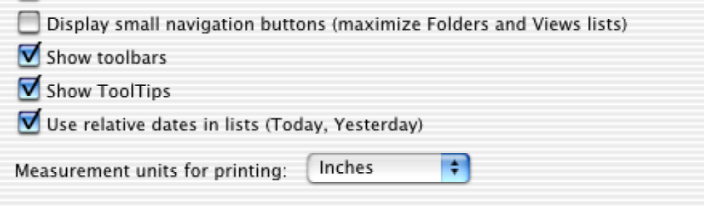
Figure 8-14, Anatomy of a preference dialog. Aggregates, called Panels, are used for grouping user interface objects that need to be resized and moved together.
Top panel
Main panel
Button panel

Slide 19
Figure 8-15, UML object diagram for the user interface objects of Figure 8-14.
prefs:Window
top:Panel
main:Panel
buttons:Panel
title:Label
c1:Checkbox
ok:Button
c2:Checkbox
cancel:Button
c3:Checkbox
c4:Checkbox

Slide 20
Figure 8-16, Applying the Composite design pattern to user interface widgets.
Component
*
move()
resize()
Label
Button
Checkbox
Composite
move()
resize()
Window
Panel
Applet

Slide 21
Figure 8-19, ARENA analysis objects related to Game independence.
Arena
LeagueOwner
Statistics
League
Game
Tournament
Player
TicTacToe
Move
Match
Chess
Result

Slide 22
Figure 8-20, Applying the Abstract Factory pattern to Games
Tournament
Game
createMatch()
createStatistics()
TicTacToe
Chess
createBulb()
createBulb()
createBlind()
createBlind()
Match
Statistics
TTTMatch
ChessMatch
TTTStats
ChessStats

Slide 23
Command Pattern: Motivation
You want to build a user interface
You want to provide menus
You want to make the menus reusable across many applications
  The applications only know what has to be done when a command from the menu is selected
  You don’t want to hardcode the menu commands for the various applications
Such a user interface can easily be implemented with the Command Pattern.
Notes:
You don’t want to hardcode the menu commands for
the various applications

Slide 24
Command pattern
Command
execute()
Invoker
Client
«binds»
ConcreteCommand1
execute()
Receiver
action1()
action2()
«binds»
ConcreteCommand2
execute()
Client (in this case a user interface builder) creates a ConcreteCommand and binds it to an action operation in Receiver
Client hands the ConcreteCommand over to the Invoker which stores it (for example in a menu)
The Invoker has the responsibility to execute or undo a command (based on a string entered by the user)
Notes:
A Command abstract class declares the interface supported by all ConcreteCommands. In the example shown here.
The client - in this case the client is a class in a user interface builder or in a class executing during startup of the application to build the user interface.
The client creates concreteCommands and binds them to specific Receivers, this can be strings like “commit”, “execute”, “undo”. So all user-visible commands are refinements of the Command abstract class.
The invoker - the class in the application program offering the menu of commands or buttons - actually invokes the concreteCommand based on the string entered and the binding between action and ConcreteCommand.
The command pattern can be nicely used to decouple interface objects from control objects:
Interface objects such as menu items and buttons, create and send messages to Command objects. Only the Command objects modify entity objects. When the user interface is changed (for example, a menu bar is replaced by a tool bar), only the interface objects are modified.

Slide 25
Comments to the Command Pattern
The Command abstract class declares the interface supported by all ConcreteCommands.
The client is a class in a user interface builder or in a class executing during startup of the application to build the user interface.
The client creates concreteCommands and binds them to specific Receivers, this can be strings like “commit”, “execute”, “undo”.
  So all user-visible commands are sub classes of the Command abstract class.
The invoker - the class in the application program offering the menu of commands or buttons - invokes theconcreteCommand based on the string entered and the binding between action and ConcreteCommand.

Slide 26
Decouples boundary objects from control objects
The command pattern can be nicely used to decouple boundary objects from control objects:
  Boundary objects such as menu items and buttons, send messages to the command objects (I.e. the control objects)
  Only the command objects modify entity objects
When the user interface is changed (for example, a menu bar is replaced by a tool bar), only the boundary objects are modified.

Slide 27
Command Pattern Applicability
Parameterize clients with different requests
Queue or log requests
Support undoable operations
Uses:
  Undo queues
  Database transaction buffering
Notes:
Encapsulate a request as an object, thereby letting you
parameterize clients with different requests,
queue or log requests, and
support undoable operations.
Uses:
Undo queues
Database transaction buffering

Slide 28
Applying the Command Pattern to Command Sets
Match
*
Move
play()
execute()
replay()
«binds»
GameBoard
TicTacToeMove
execute()
ChessMove
execute()

Slide 29
Figure 8-21, Applying the Command design pattern to Matches and ReplayedMatches in ARENA.
ReplayedMatch
Match
*
Move
nextMove()
play()
execute()
previousMove()
replay()
«binds»
GameBoard
TicTacToeMove
ChessMove

Slide 30
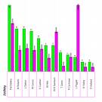



Observer Pattern Motivation
Portfolio
*
Stock
Problem:
  We have an object that changes its state quite often
    Example: A Portfolio of stocks
  We want to provide multiple views of the current state of the portfolio
    Example:Histogram view, pie chart view, time line view, alarm
Requirements:
  The system should maintain consistency across the (redundant) views, whenever the state of the observed object changes
  The system design should be highly extensible
    It should be possible to add new views without having to recompile the observed object or the existing views.

Slide 31
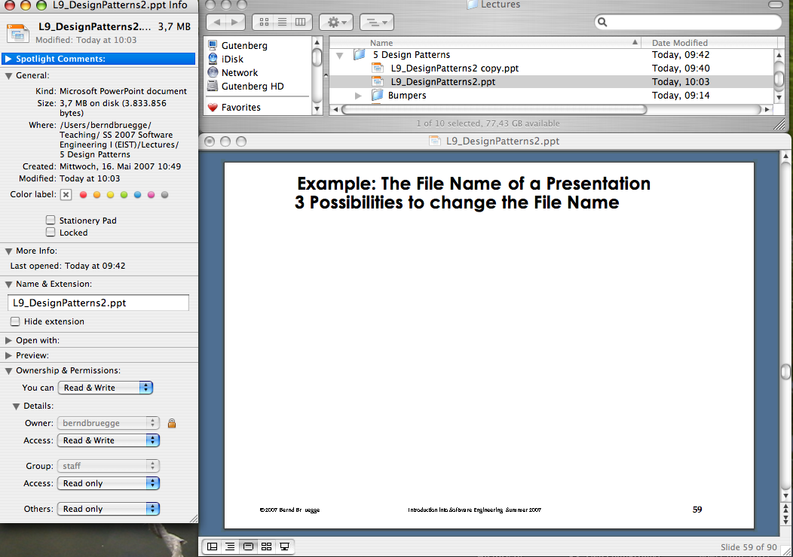
Example: The File Name of a Presentation
3 Possibilities to change the File Name
List View
Powerpoint
View
What happens
if I change
the file name of this presentation in List View
to foo?
InfoView

Slide 32
Observer Pattern: Decouples an Abstraction from its Views
Subject
Observer
observers
*
subscribe(subscriber)
unsubscribe(subscriber)
notify()
update()
ConcreteSubject
ConcreteObserver
state
observeState
getState()
setState()
update()
The Subject (“Publisher”) represents the entity object
Observers (“Subscribers”) attach to the Subject by calling subscribe()
Each Observer has a different view of the state of the entity object
  The state is contained in the subclass ConcreteSubject
  The state can be obtained and set by subclasses of type ConcreteObserver.
Notes:
The Publisher is called Subject, the Subscriber is called Observer in Gamma.

Slide 33
Observer Pattern
Models a 1-to-many dependency between objects
  Connects the state of an observed object, the subject with many observing objects, the observers
Usage:
  Maintaining consistency across redundant states
  Optimizing a batch of changes to maintain consistency
Three variants for maintaining the consistency:
  Push Notification: Every time the state of the subject changes, all the observers are notified of the change
    Push-Update Notification: The subject also sends the state that has been changed to the observers
  Pull Notification: An observer inquires about the state the of the subject
Also called Publish and Subscribe.

Slide 34
Modeling the event flow:
Change FileName to “foo”
Subject
observers
*
Observer
subscribe(subscriber)
unsubscribe(subscriber)
notify()
update()
ConcreteSubject
ConcreteObserver
state
observeState
getState()
setState()
update()
FileName:
Subject
InfoView:
ConcreteObserver
ListView:
ConcreteObserver
PowerpointView:
ConcreteObserver
FileName:
ConcreteSubject
Pull-
Notification
subscribe()
getState()
“L9_DesignPatterns2.ppt”
update()
subscribe()
subscribe()
setState(“foo”)
Is this a correct model
of the reality?
Push-Update
Notification
notify()
Push-
Notification
update()
update()
update()
getName()
“foo”
getName()
“foo”

Slide 35
Applying the Observer Pattern to maintain Consistency across Views
Subject
subscribe()
unsubscribe()
notify()
*
Observer
update()
File
-filename
InfoView
update()
getState()
setState()
ListView
update()
PowerpointView
update()

Slide 36
Applying the Observer Design Pattern to maintain Consistency across MatchViews
observers
Subject
Observer
1
*
subscribe(Subscriber)
update()
unsubscribe(Subscriber)
notify()
GameBoard
MatchView
state
gameBoard
getState()
update()
playMove()
Push, Pull or Push-Update Notification?

